Slide 1

Bundling Innovations for
Agri-Food Systems Transformation:
Some Reflections for Canadian Leaders
Christopher B. Barrett
Cornell University
Canadian Agri-Food Policy Institute
Big Solutions Forum
May 11, 2021

Slide 2












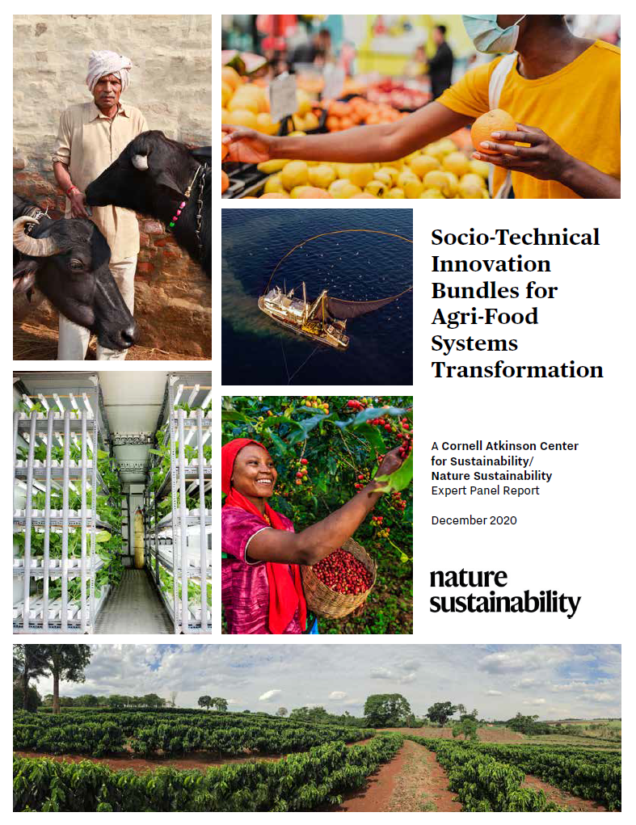











Expert panel
Cornell Atkinson – Nature Sustainability 2020 expert panel on “Innovations to Build Sustainable, Equitable, Inclusive Food Value Chains,” a diverse group of 23 experts from across disciplines, regions, organizations, etc., w/10 additional co-authors.
Report issued Dec. 2020 on Nature web site. Book forthcoming in Palgrave Macmillan SDG series.
Based on the”, released Dec. 2020.

Slide 3
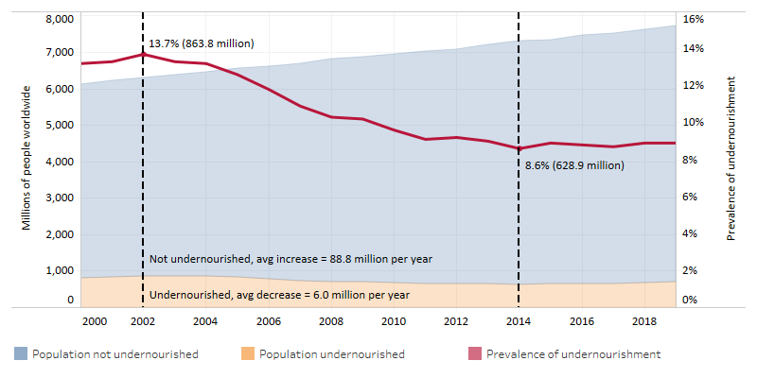
Core motivation
We must hold two fundamental truths firmly in mind:
(1) 1960s/70s objectives – grow supply of staple cereals to avert famine – sparked AFS innovations that enabled huge advances in human well-being.
(2) Those innovations also had major, adverse, unsustainable spillover effects on climate, natural environment, public health/nutrition, social justice.
We must update objectives, accelerate/reorient innovations for 21st century.

Slide 4
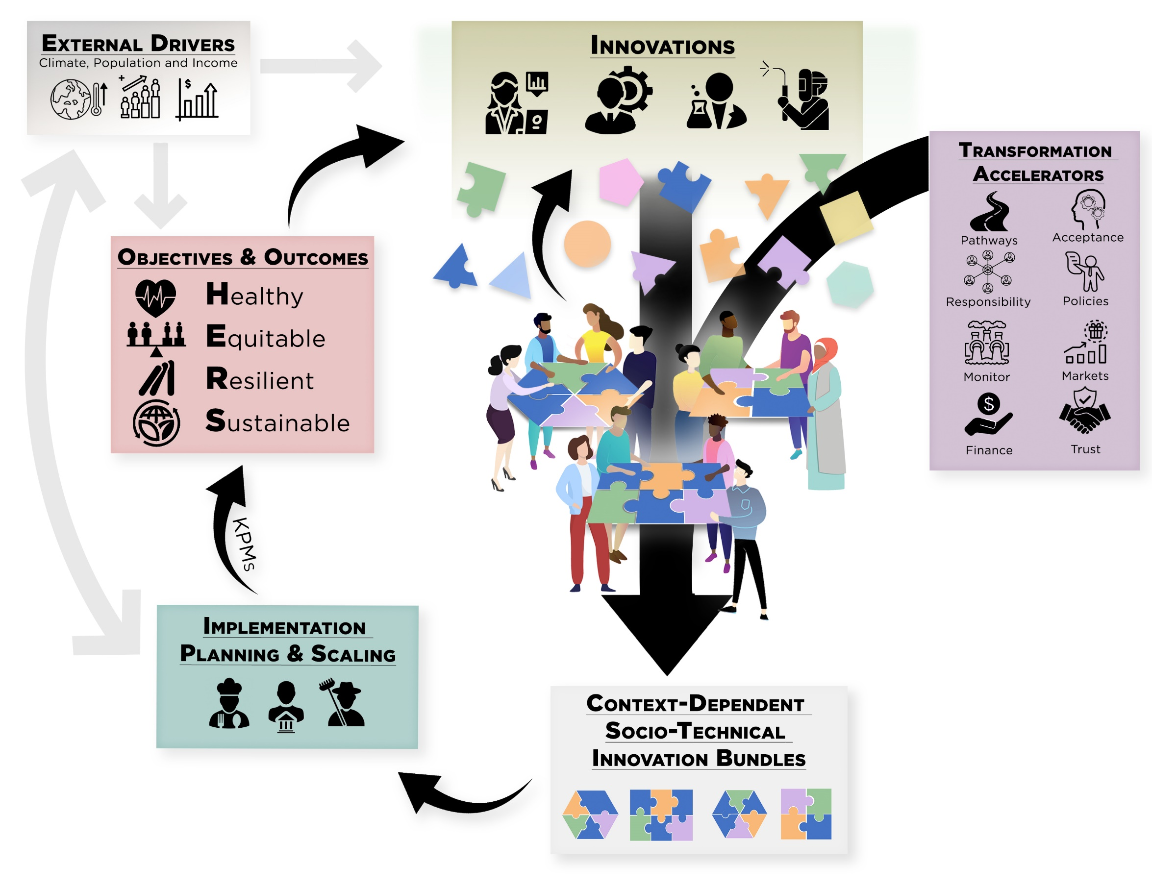
Key conclusions
Build around a shared vision of HERS agri-food systems.
Must embrace multiple objectives simultaneously:

Slide 5

Key conclusions
Must design for future states, not today’s. Looking 25-50 yrs ahead (past 2030 SDGs, to scaled impact of emergent and ideated innovations), 3 major changes loom:
Climate change
Population shifts – urbanization, aging
Income growth
Two key implications:
Pay FAR more attention to Africa … will account for >50% of global food demand growth to 2100
Canada relatively favorably positioned – bilingual, net agronomic gains, land for post-ag rural economy

Slide 6
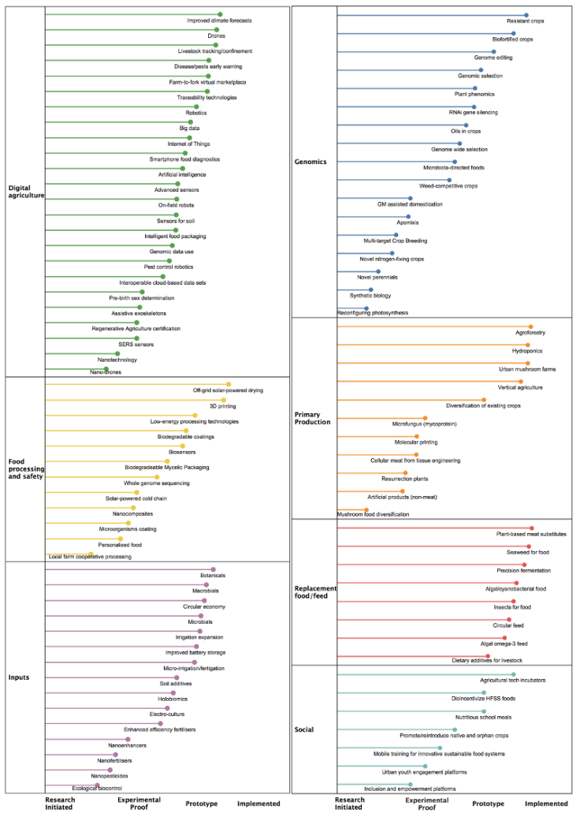
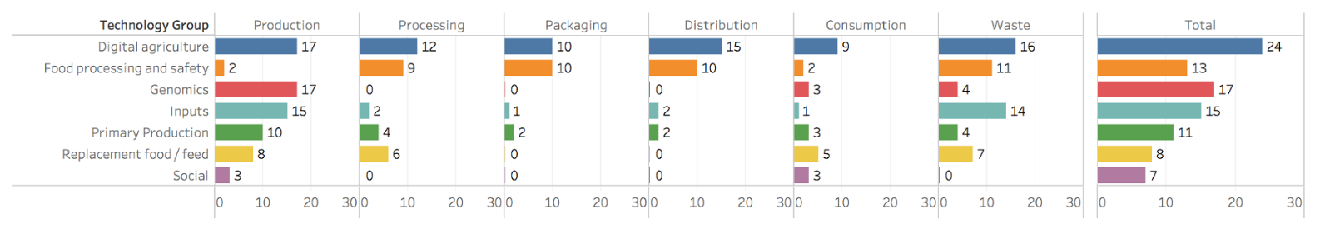
Key conclusions
A profuse pipeline exists of promising (natural and social) science advances at various stages of deployment readiness. Span value chains and geographies.

Slide 7
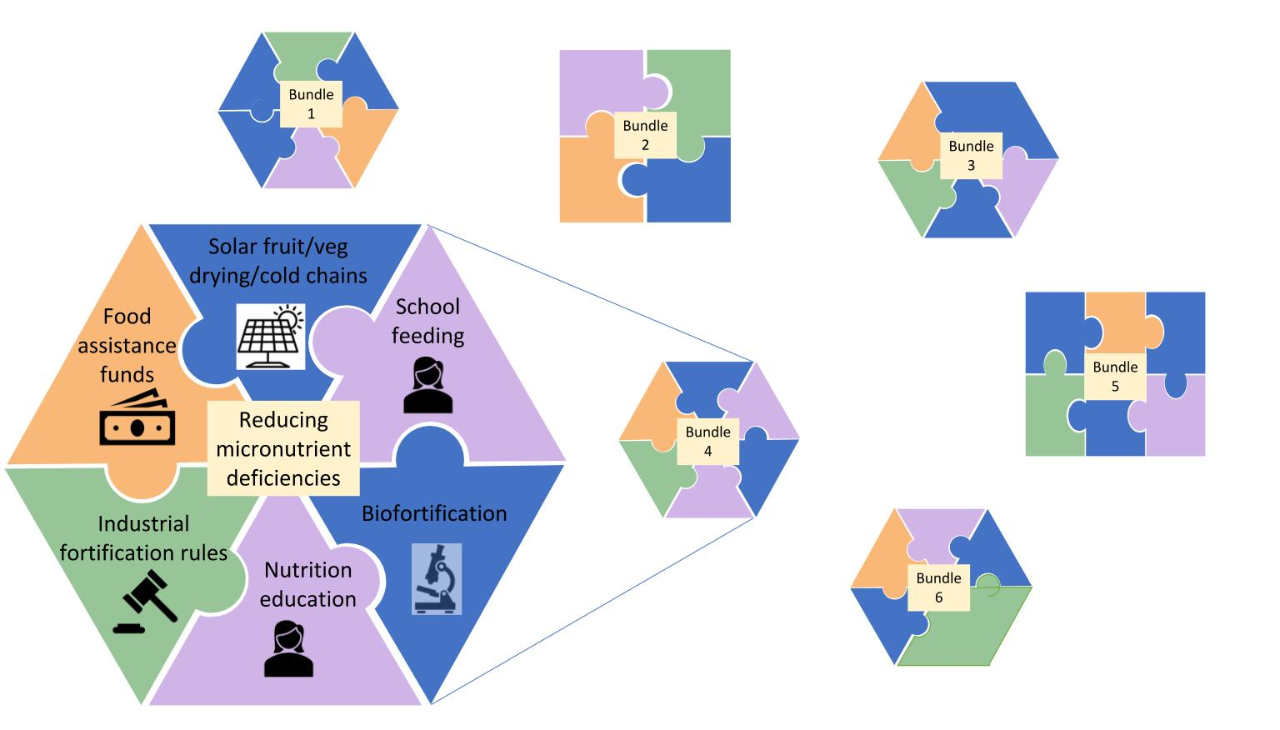
7 Essential Actions
Develop socio-technical innovation bundles
No magic bullets exist. Need to bundle in order to:
  realize synergies needed to adapt/scale (Green Revolution lesson)
  address political economy arising from spillovers (alt protein lesson)
  meet heterogeneous needs (micronutrient deficiencies lesson)

Slide 8

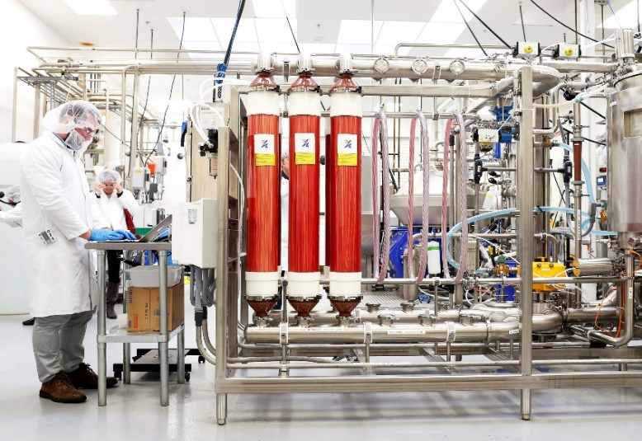
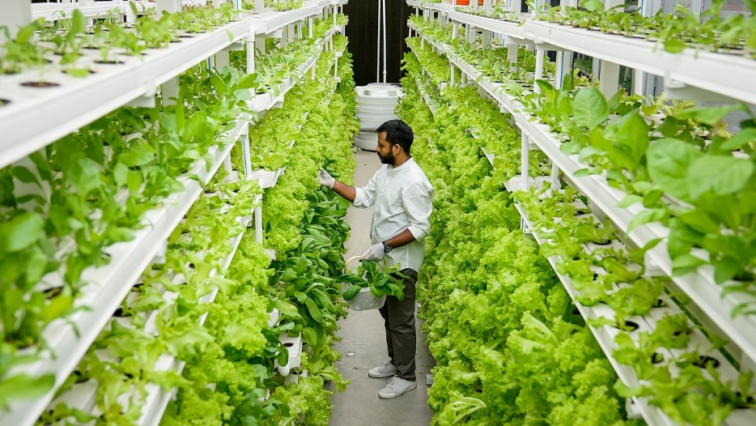
7 Essential Actions
2. Reduce the land and water footprint of food
Decoupling food production from land is increasingly necessary, as well as culturally, economically, technologically feasible.
Challenge: Managing de-agrarianization’s creative destruction.
Canada has some advantages in this transition if it moves quickly.
Photo: Gerry Machen/Creative Commons
Photo: Beck Deifenbach/Reuters
Photo: Betterindia.com

Slide 9
7 Essential Actions
3. Reconfigure public support for AFSs
Two key roles for gov’ts:
1. invest in essential public goods and services: e.g., NSF-funded research
2. facilitate dialogue to find cooperative solutions: e.g., workshops like this!
Much current government AFS spending is wasteful ($2bn/day!)
Must redirect towards social protection programs, agri-food research, and physical and institutional infrastructure.
Foster civil society dialogues to identify and support contextually appropriate socio-technical bundles.
Again, Canada seems to have some advantages here over EU, US, Japan, BRICS

Slide 10
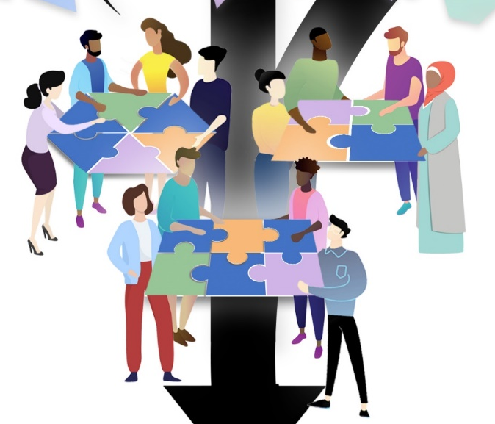
Other Essential Actions
4. Commit to co-creation with shared and verifiable responsibility Agreed KPMs, safety nets, penalties can accelerate beneficial innovation and minimize adverse unintended consequences.
5. Deconcentrate power
Reducing market and political power imbalances and broadening participation in innovation dialogues can accelerate innovation.
6. Mainstream systemic risk management
COVID-19 underscores the rising importance of effective systemic risk management. Need innovative risk reduction and risk transfer mechanisms.
7. Develop novel financing mechanisms
AFS innovations require $$$ (hundreds of billions annually).
How to mobilize private resources beyond public spending/philanthropy?
Latent Canadian advantage: trusted agent – low-cost verifiability of product attributes:
ESG (GHG, water, chemicals, labor); healthful foods,

Slide 11
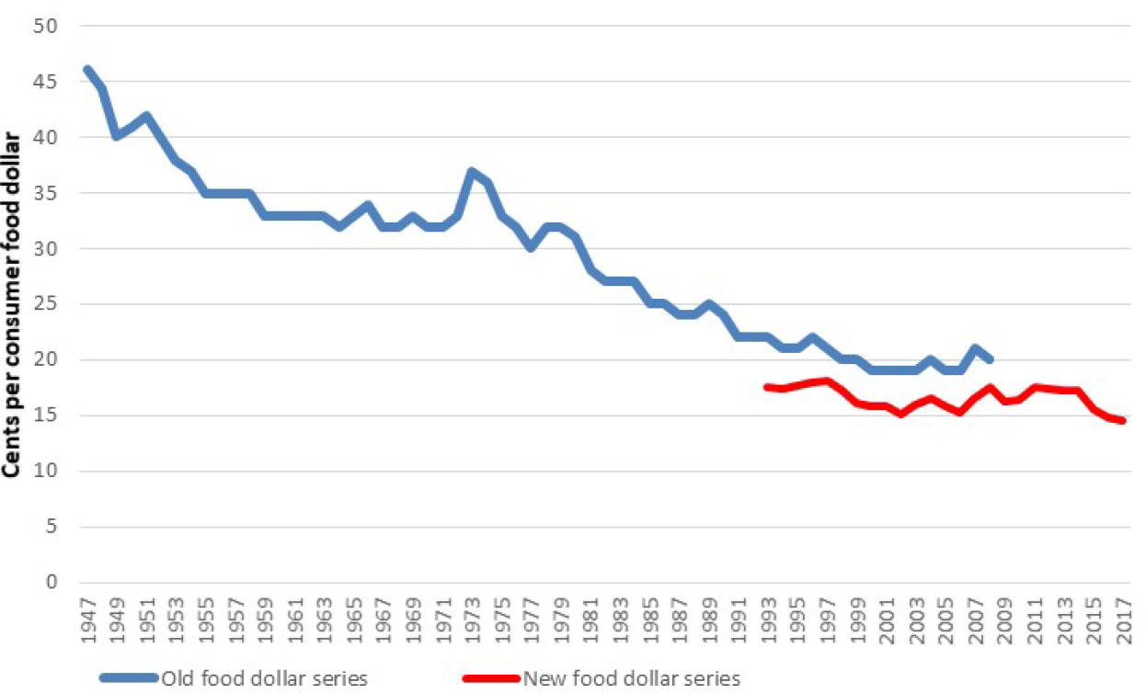
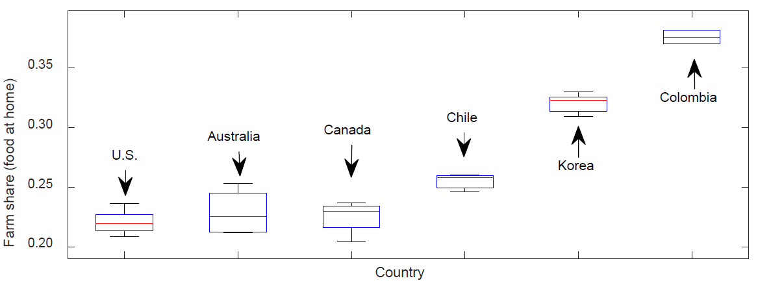
Canada’s big challenges
Post-harvest value addition
Globally, 73% of consumer spending on FAH (91% on FAFH) accrues to post-harvest value chain actors. Post-harvest share will inevitably continue growing. Must build value addition capacity for export markets.
Source: Yi et al. Nature Food in press

Slide 12
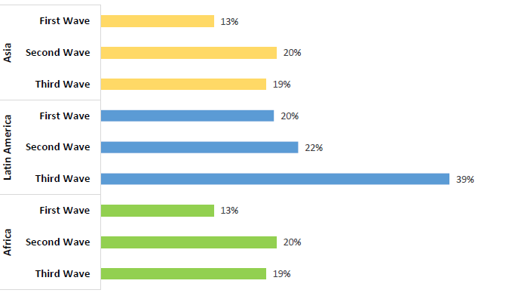
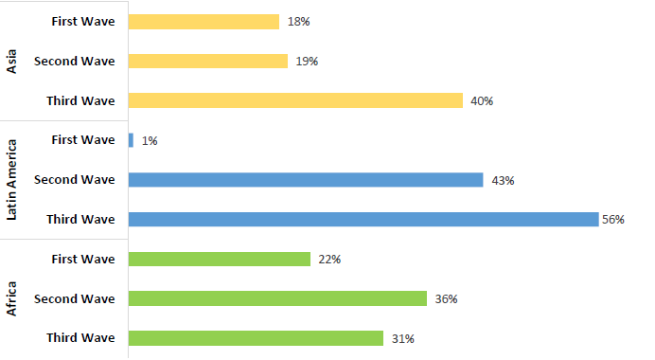
Canada’s big challenges
Connecting to food retail and food service in LMICs
Extremely rapid agri-food value chain transformations happening in LMICs, esp. downstream. Brands and FDI, not just commodity trade, keys to mkt expansion.
Source: Barrett et al. Journal of Economic Literature in press

Slide 13
Summary
Dramatic transformation of agri-food systems is both needed and essential.
Bundling social and technological changes is key.
Canada has some natural advantages: geography, reputation, culture/language
Also some challenges: must build post-harvest value addition and presence in consumer-facing LMICs agri-food value chains that are the main growth markets.

Slide 14

Thank you
Report and associated journal articles, videos, etc. available at https://blogs.cornell.edu/nature-sustainability/
Thank you for your time and interest!

